Slide 1
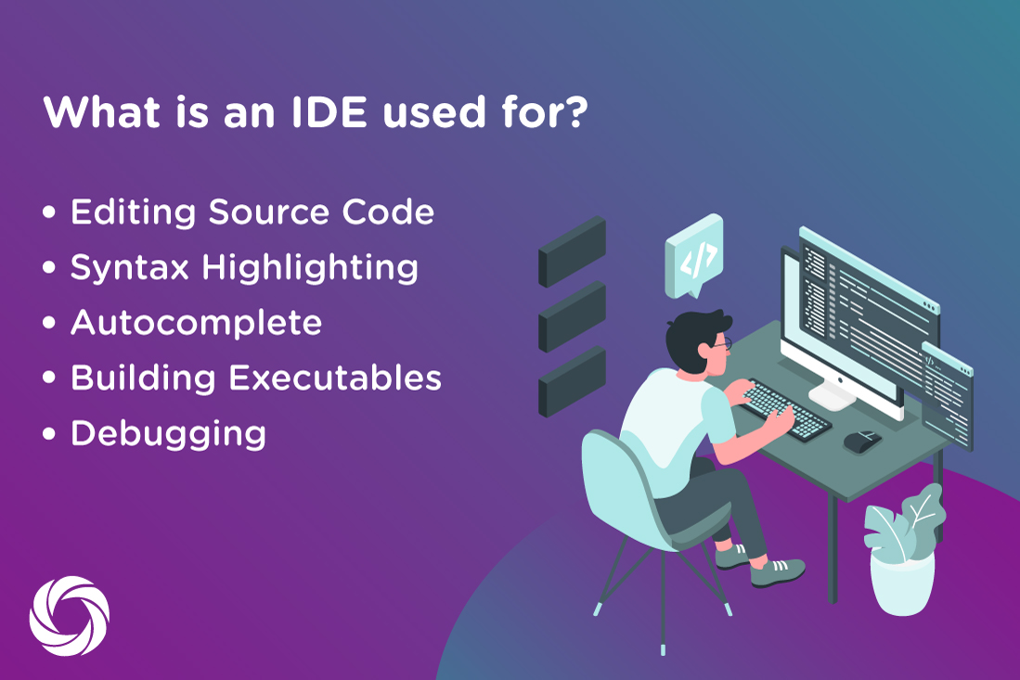
Integrated Development Environment (IDE)
An integrated development environment (IDE) is software for building applications that combines common developer tools into a single graphical user interface (GUI).
An IDE typically consists of:
Source code editor: A text editor that can assist in writing software code with features such as syntax highlighting with visual cues, providing language specific auto-completion, and checking for bugs as code is being written.
Local build automation: Utilities that automate simple, repeatable tasks as part of creating a local build of the software for use by the developer, like compiling computer source code into binary code, packaging binary code, and running automated tests.
Debugger: A program for testing other programs that can graphically display the location of a bug in the original code.

Slide 2
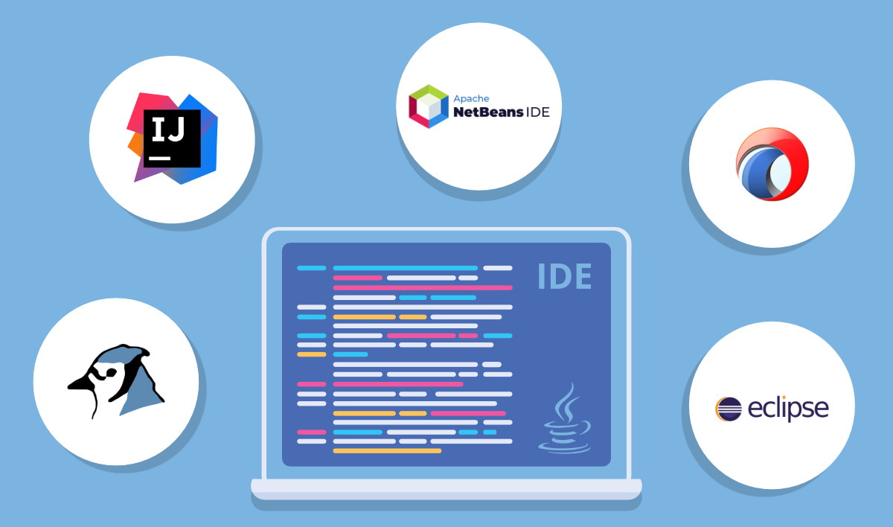
Integrated Development Environment (IDE)
Difference between Text editor and IDE(Integrated development environment)
The name “Text editor” and “IDE “ is not new words for the developer dictionary. If those are new to them, so they are not developers. Because IDE’s and Text Editors are regularly used for writing code nicely and cleanly.
Text Editors have a more widespread approach than IDE. Because, with the help of text editors we are having the ability to code using different languages. The most famous text editors are, VS Code, Atom, Sublime
IDE stands for an integrated development environment (Somewhere you found an integrated design environment or integrated debugging environment). The word integrated in IDE, Because it includes/integrated everything that a programmer could want to do on their projects. Examples for an IDE are as follows, Eclipse ,Netbeans ,Android Studio

